Slide 1
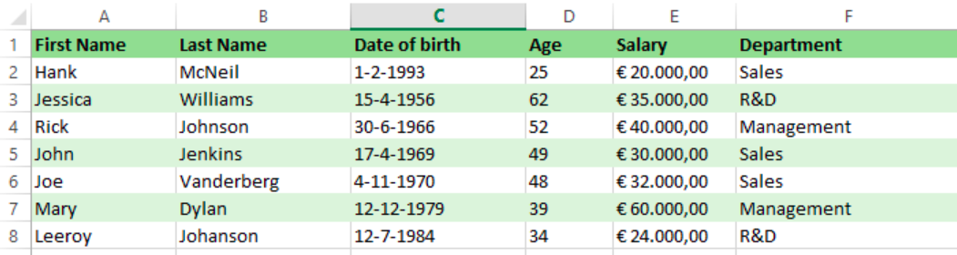
Correlated subquery primer
Get employees earning more than the average salary

Slide 2
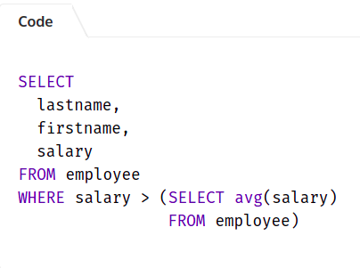
Simple subquery
Get employees earning more than the average salary

Slide 3
Simple subquery?
find all employees with a salary higher than their average departmental salary.

Slide 4
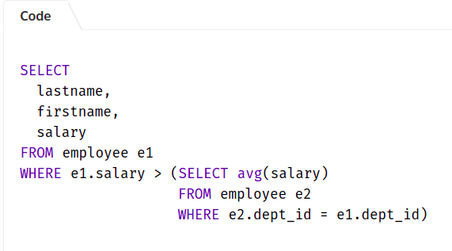
Simple subquery?
find all employees with a salary higher than their average departmental salary.

Slide 5
Simple subquery?
find all employees with a salary higher than their average departmental salary.

Slide 6
Simple vs correlated

Slide 7
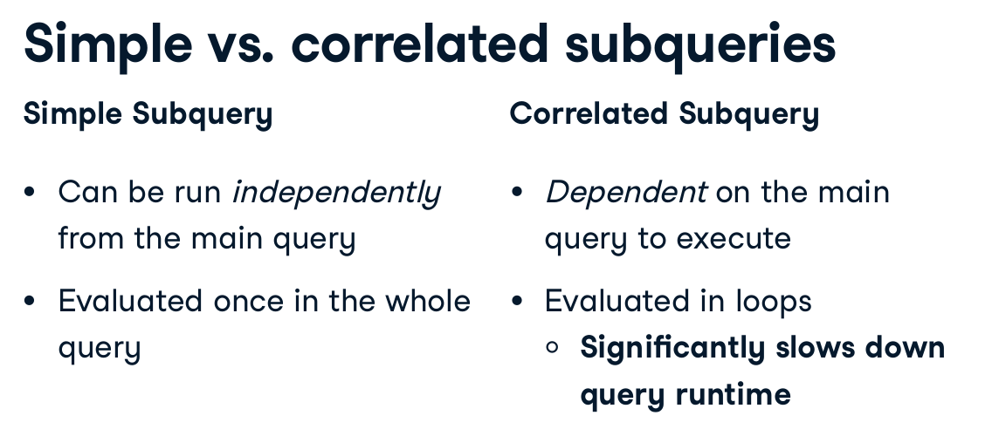
Correlated subqueries

Slide 8
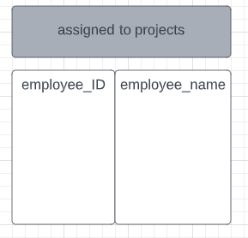

find all employees who are not assigned to any projects

Slide 9
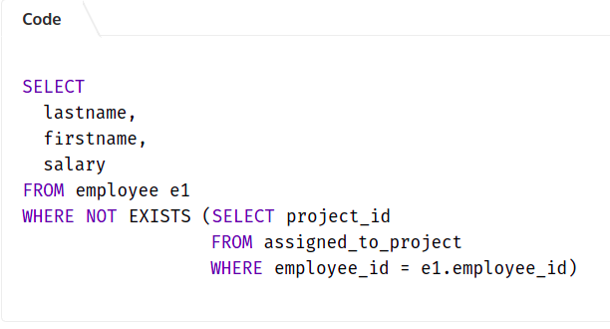
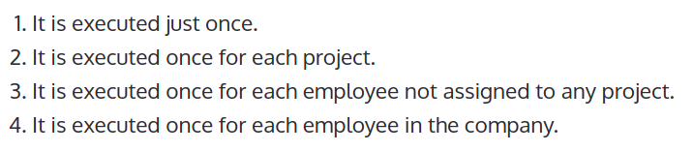
how many times the SQL correlated subquery is executed?

Slide 10
Solution
how many times the SQL correlated subquery is executed?

Slide 11
find all employees who are not assigned to any projects
how many times the SQL correlated subquery is executed?

Slide 12
When can we avoid?
find all employees with a salary higher than their average departmental salary.
Window functions

Slide 13
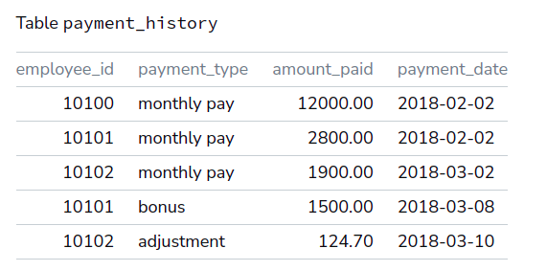
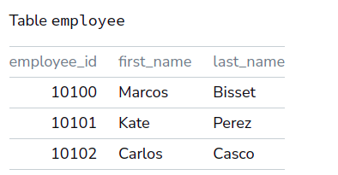
What solutions are available?
List the employees who have never received a bonus.

Slide 14
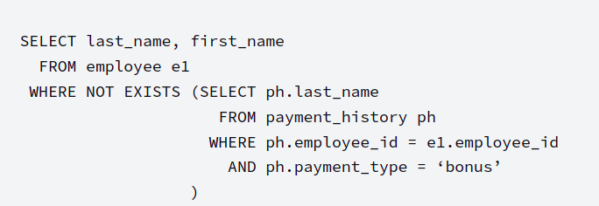
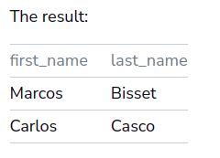
Correlated Subquery
List the employees who have never received a bonus.
EXIST WITH SUBQ - FAST TO
THE POINT

Slide 15
When can’t we avoid correlated SubQ?
find all employees who are not assigned to any projects
List the employees who have never received a bonus.
ANYTHING COMMON?

Slide 16
When can’t we avoid correlated SubQ?
find all employees who are not assigned to any projects
List the employees who have never received a bonus.
ANYTHING COMMON?
NEGATIVES!

Slide 17
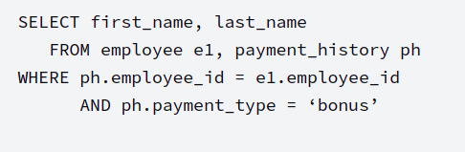
What About Positive Data Questions?
List the employees who have received a bonus.
وديتوا الجوين فيين ؟

Slide 18
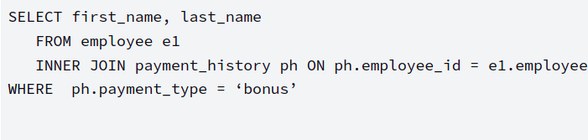
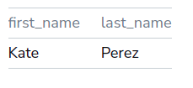

Implicit join :)
Performance difference?
USE JOIN instead of a correlated subquery whenever possible.

Slide 19

MORE INFO
https://bipp.io/sql-tutorial/advanced-sql/sql-correlated-subqueries/

Slide 20

More info
https://learnsql.com/blog/correlated-sql-subqueries-newbies/

Slide 21
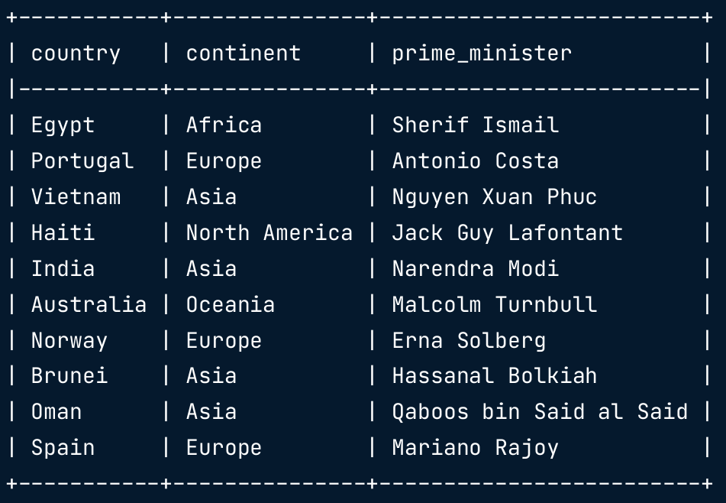
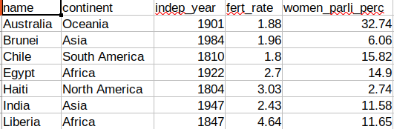
What about SELECT clause?
count the number of countries listed in the states table for each continent in the prime_ministers table

Slide 22
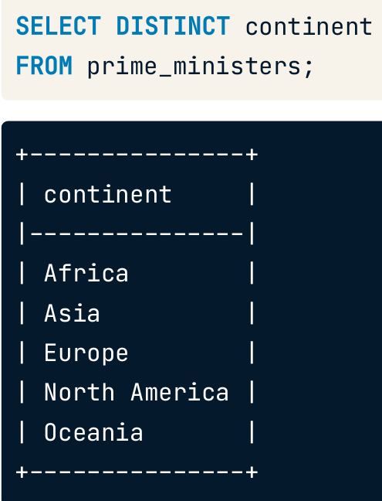
Step 1

Slide 23
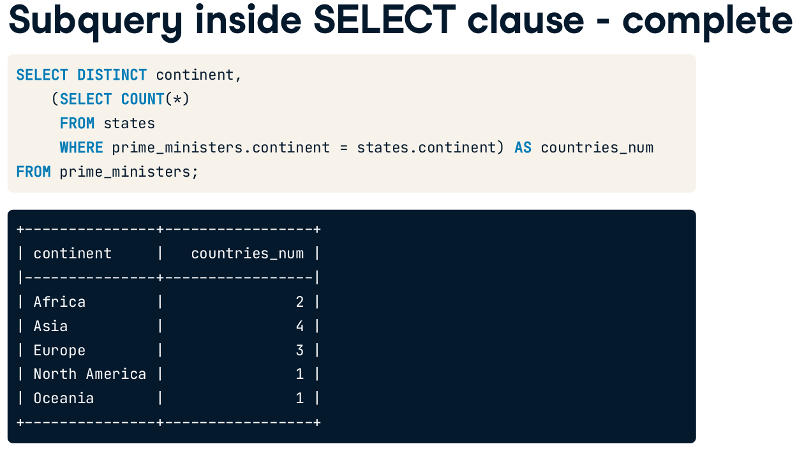
Finishing step?
Are the queries related?
Outcome of inner query?
Notes:
array

Slide 24
Finishing step?
Notes:
array

Slide 25
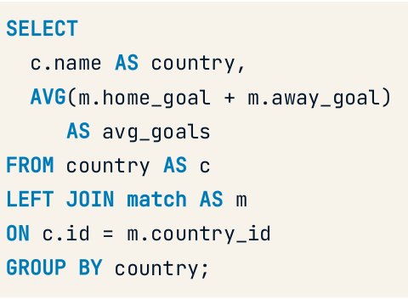
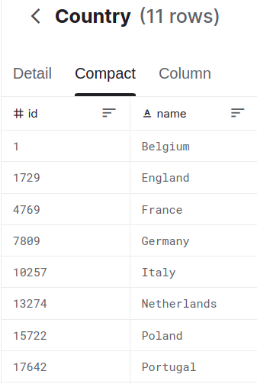
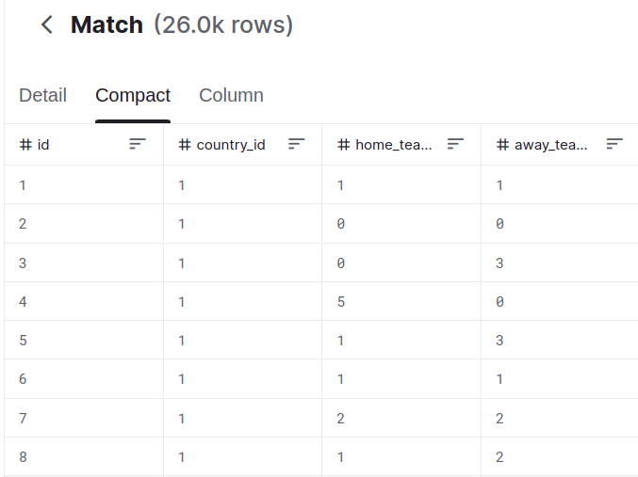
Convert to correlated
What is the average number of goals scored in each country?

Slide 26
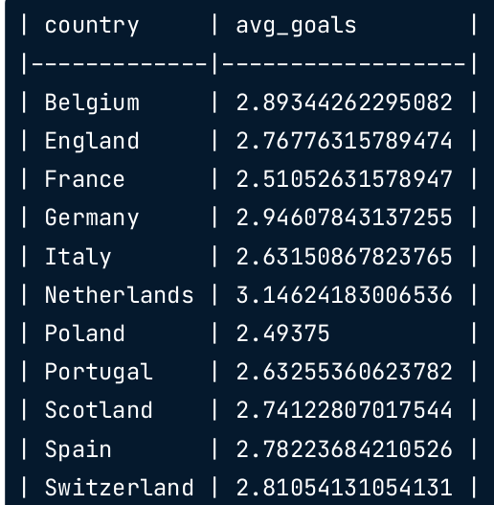
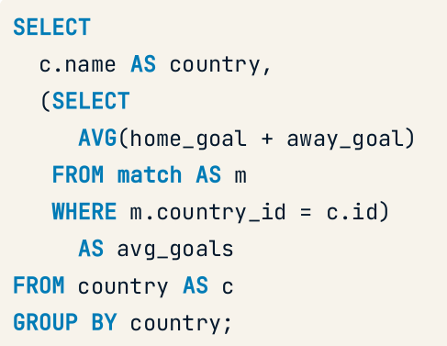
Convert to correlated
What is the average number of goals scored in each country?
How is avg in inner query and the group by in outer query?
Notes:
Inner correlated query is evaluated once for every row of outer query. Thus it benefits from the outside group by. Ana ba5amen

Slide 27
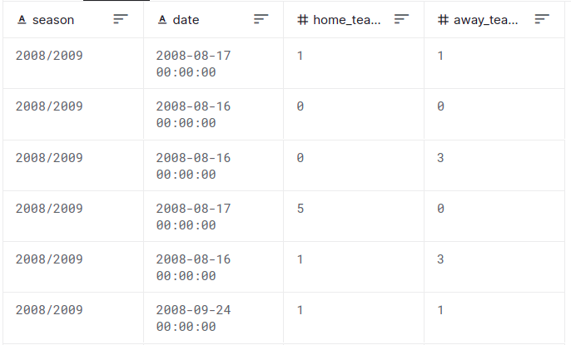
Nested subqueries
How does each month's total goals differ from the average monthly total of goals scored?
Mention the steps!

Slide 28
Nested subqueries
How does each month's total goals differ from the average monthly total goals scored?
1- get total goals by month
2- average them
3- get the difference
Mention the steps!

Slide 29
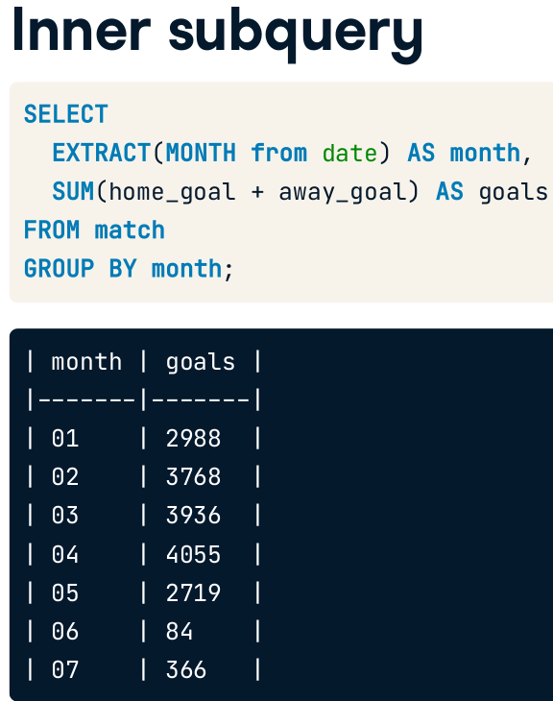
Nested subqueries
How does each month's total goals differ from the average monthly total of goals scored?
1- get total goals by month
2- average them
3- get the difference

Slide 30
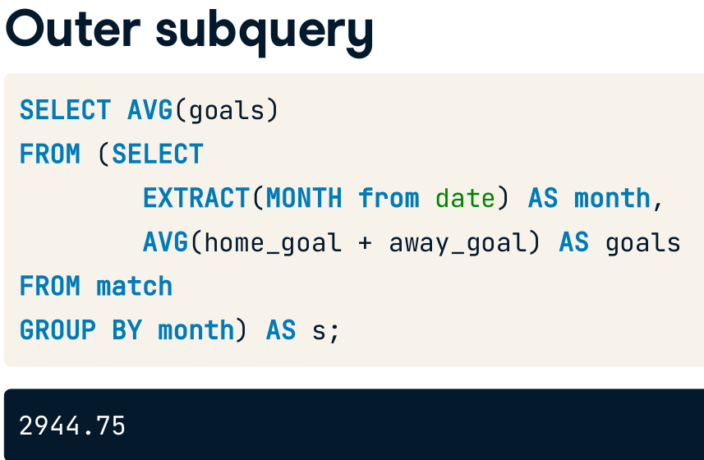
Nested subqueries
How does each month's total goals differ from the average monthly total of goals scored?
1- get total goals by month
2- average them
3- get the difference

Slide 31
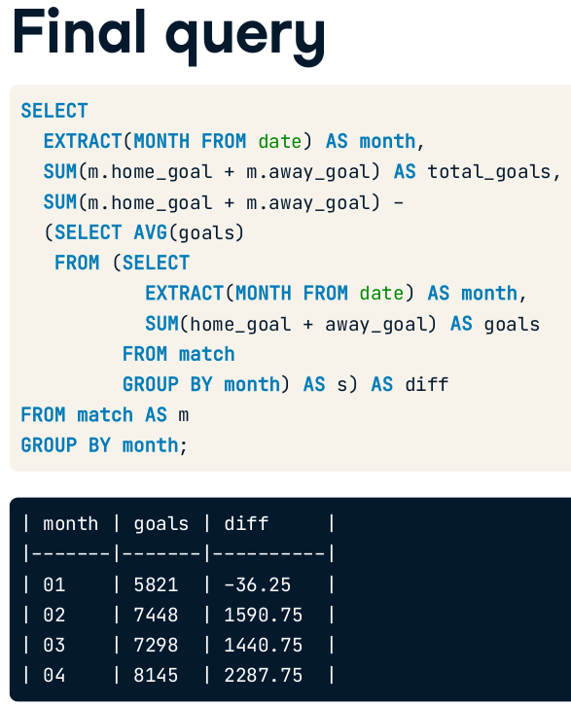
1- get total goals by month
2- average them
3- get the difference
Can we refactor?
Notes:
I think we can use with.
Maybe diff average can be converted to CTE ? Can we do this if it is scalar?
But can’t we make more than this

Slide 32
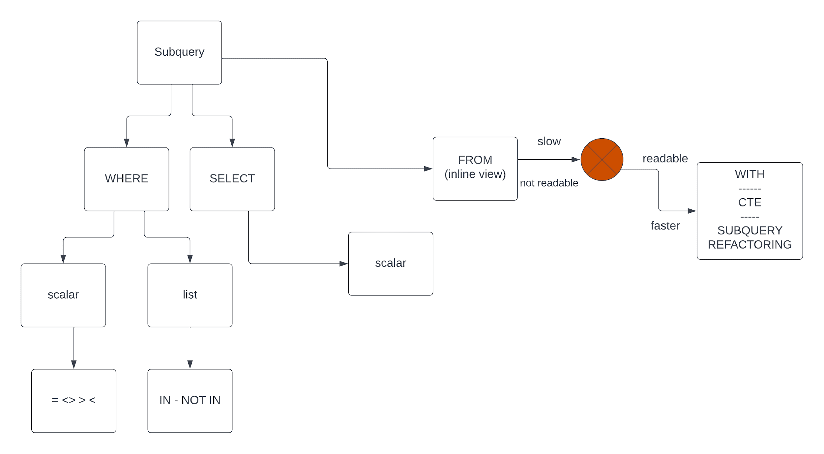
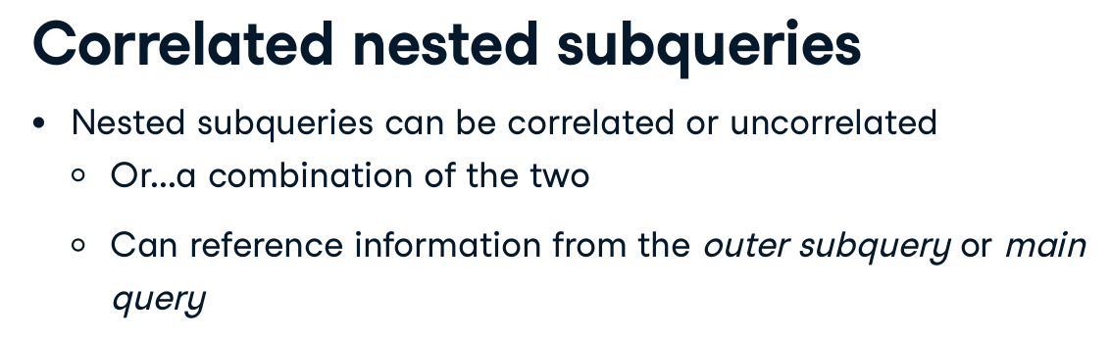
summary

Slide 33
CTE
The main advantage of the Common Table Expression (when not using it for recursive queries) is encapsulation, instead of having to declare the sub-query in every place you wish to use it, you are able to define it once, but have multiple references to it.
https://stackoverflow.com/questions/706972/difference-between-cte-and-subquery#:~:text=Adding%20to%20others'%20answers%2C%20if,to%20reuse%20your%20code%20better.

Slide 34
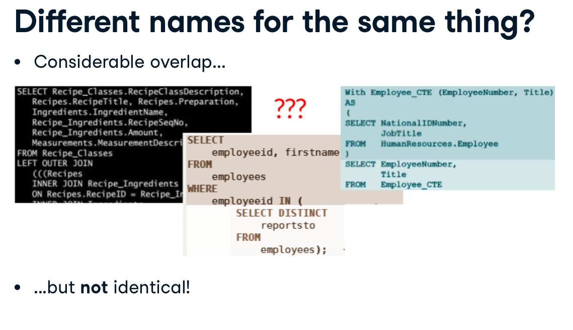

Slide 35
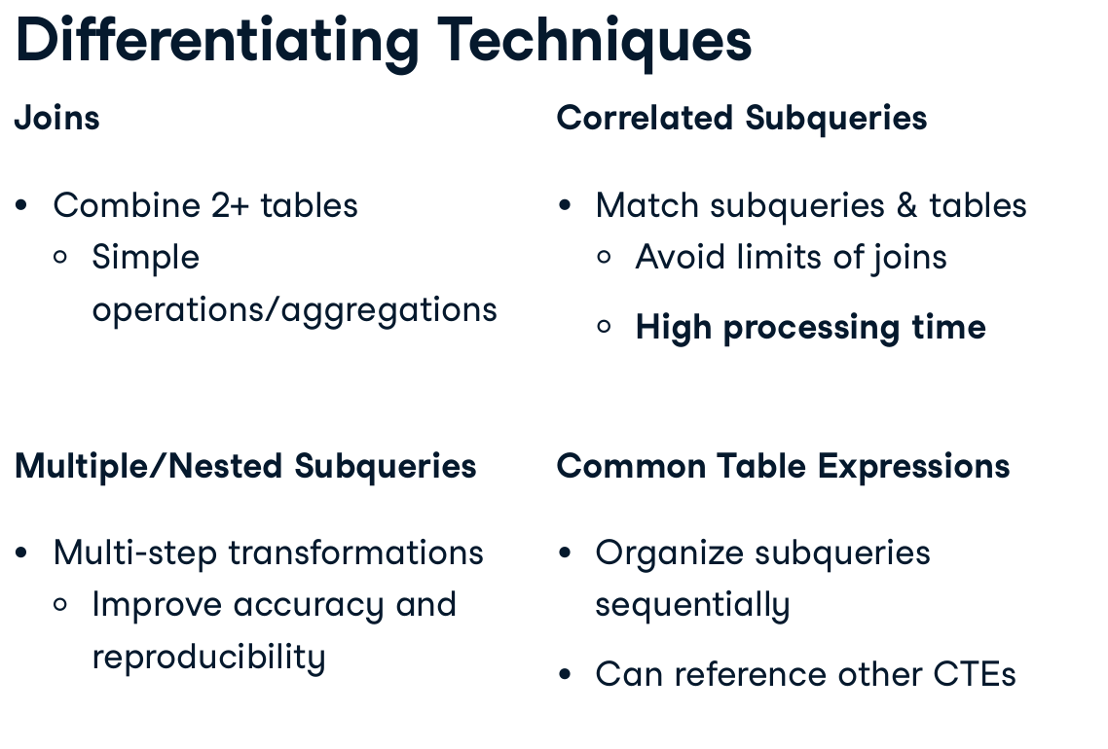
Recall the limits for the join, either from this course (match ) or from other previous slides (self join with duplicates)
Can CTE replace nested subqueries, if they can reference other CTEs and themselves?
Window functions, can they replace correlated subquery?

Slide 36
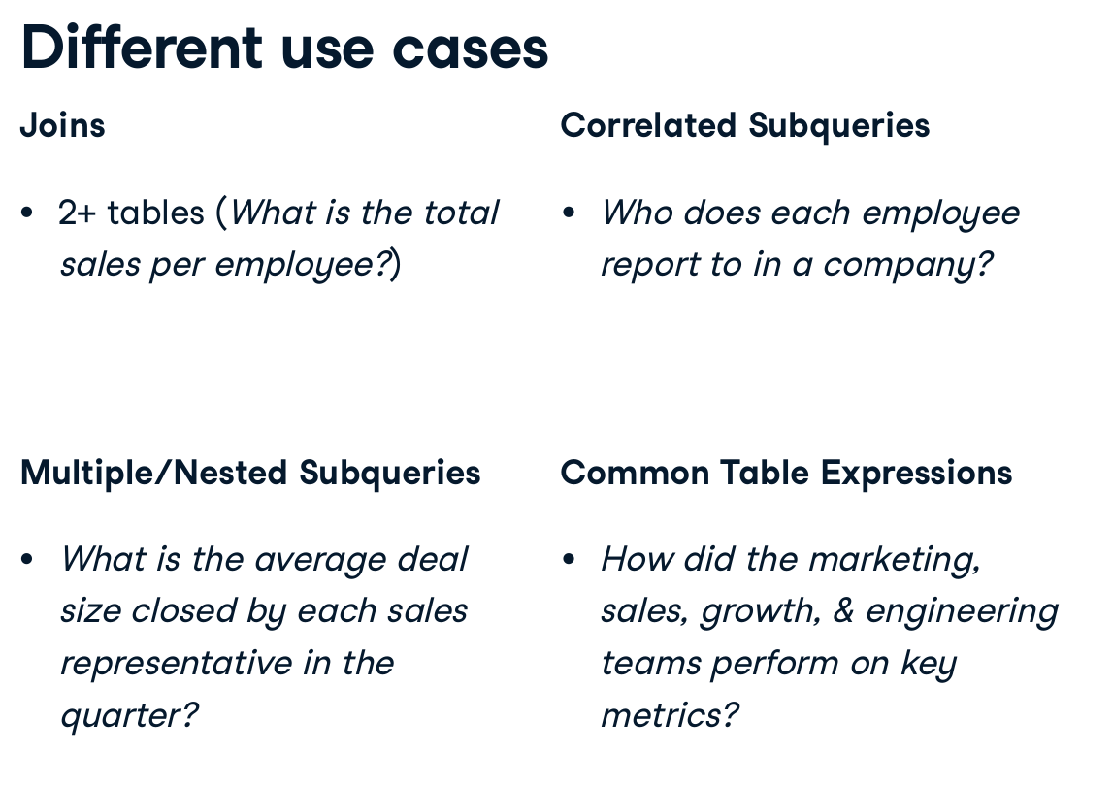

Slide 37
Challenge
https://campus.datacamp.com/courses/improving-query-performance-in-postgresql/bringing-together-the-data?ex=6
https://campus.datacamp.com/courses/improving-query-performance-in-postgresql/bringing-together-the-data?ex=7
https://campus.datacamp.com/courses/improving-query-performance-in-postgresql/bringing-together-the-data?ex=8

Slide 38

Very nice course
https://app.datacamp.com/learn/courses/intermediate-sql
But still misses something

Slide 39

https://app.datacamp.com/learn/courses/improving-query-performance-in-postgresql

Slide 40
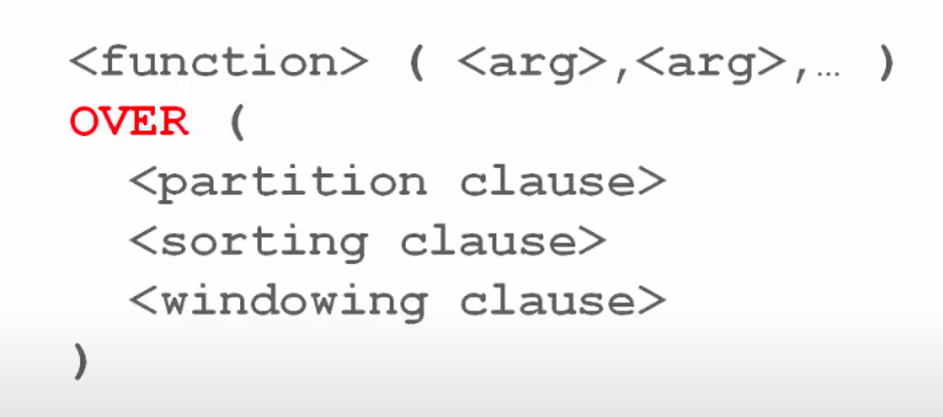
What about analytics/window functions?

Slide 41


Slide 42


Slide 43
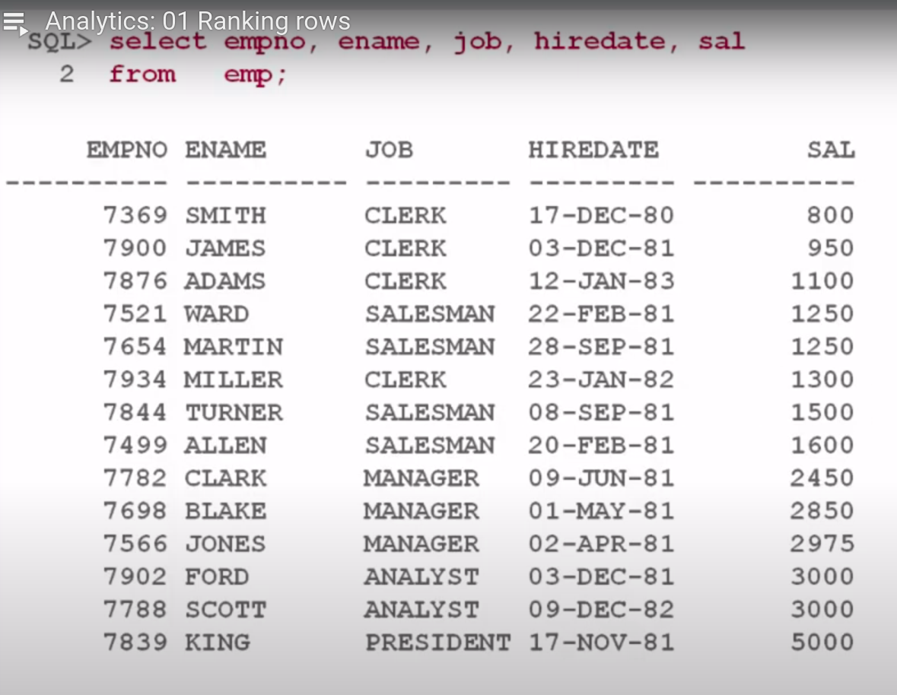

Slide 44
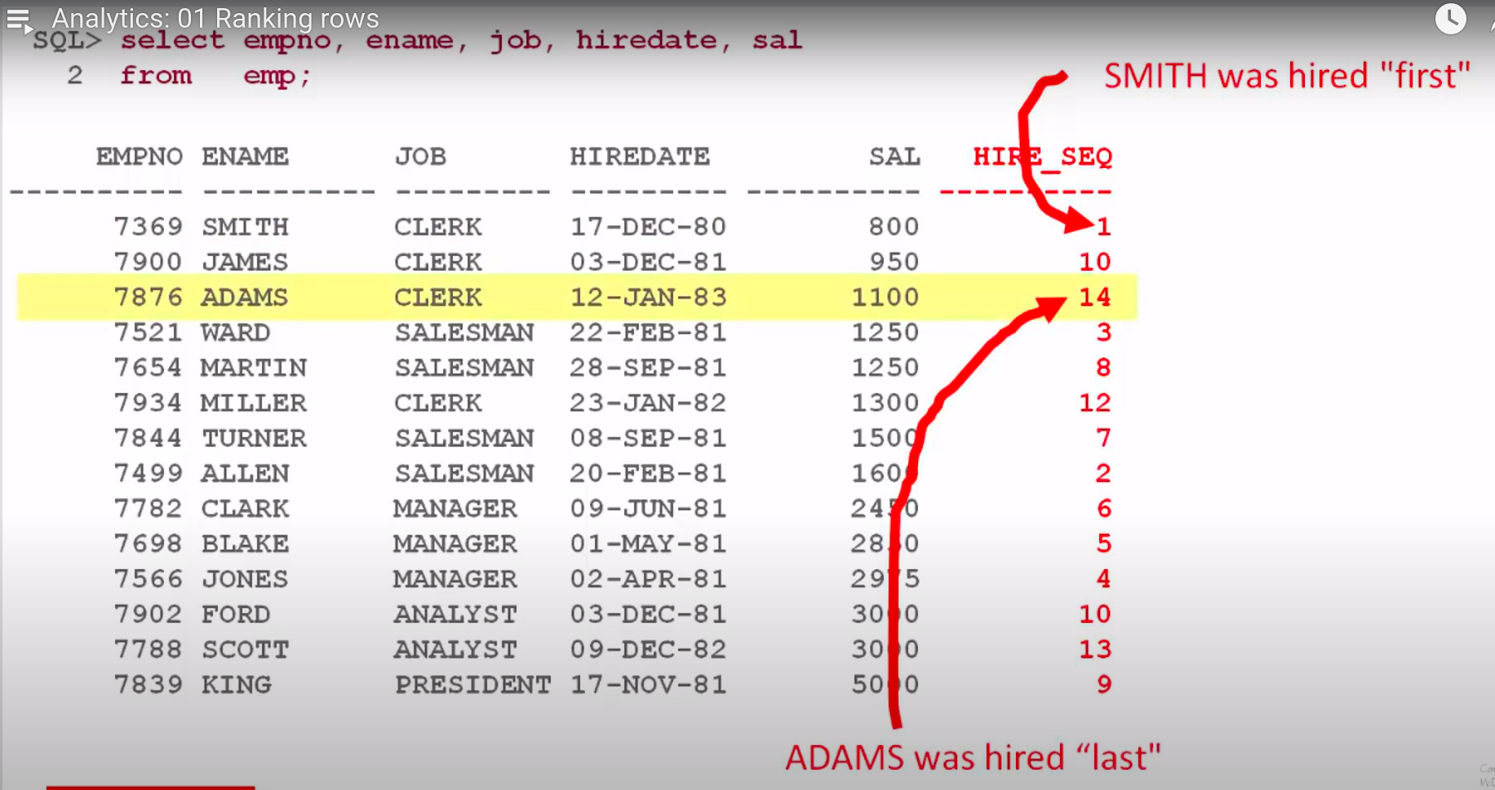
Expected output

Slide 45
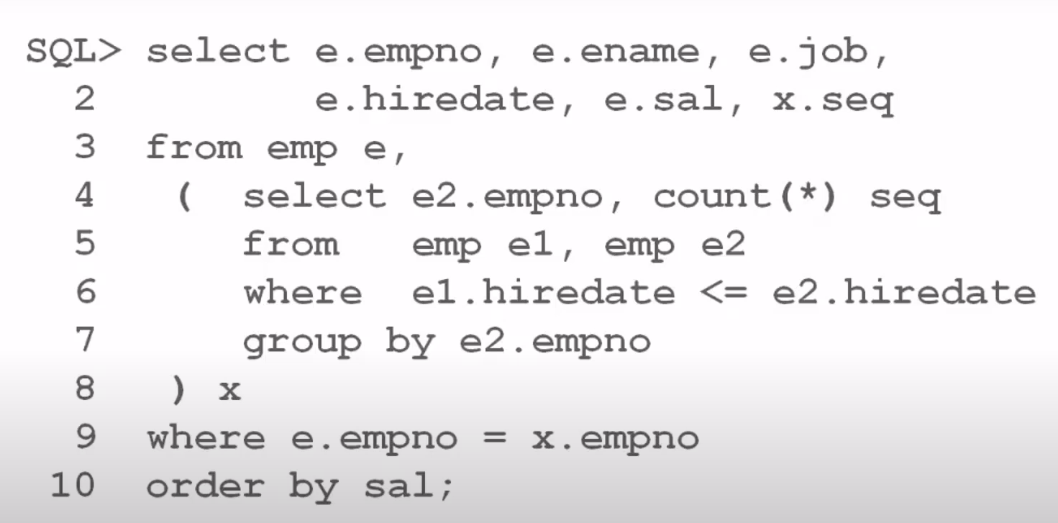

Slide 46
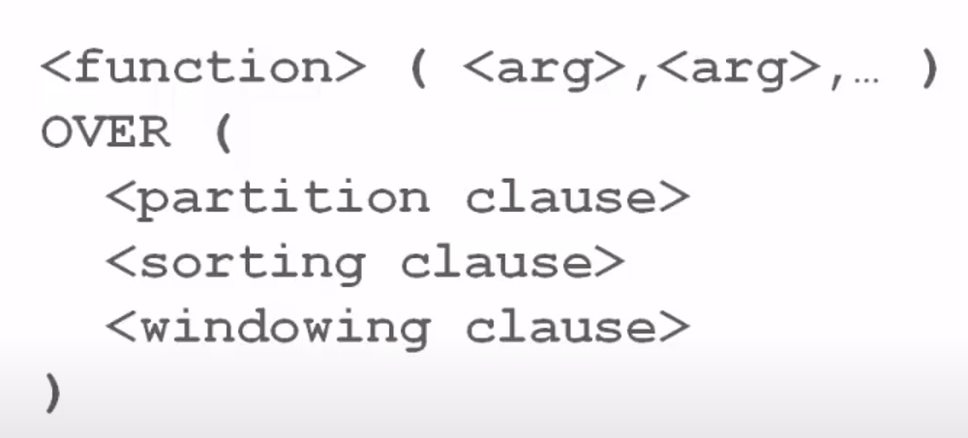
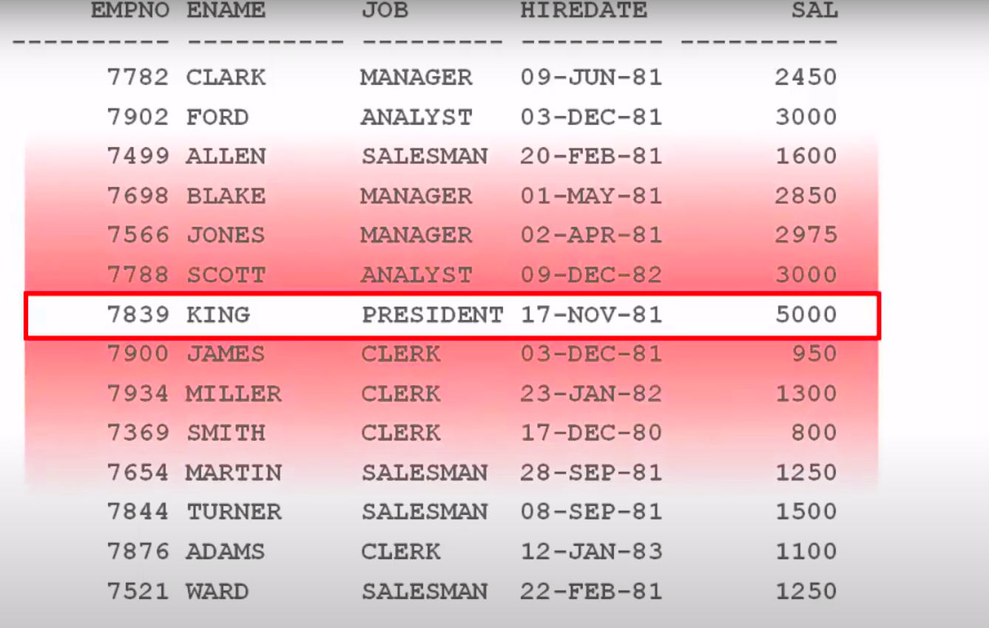
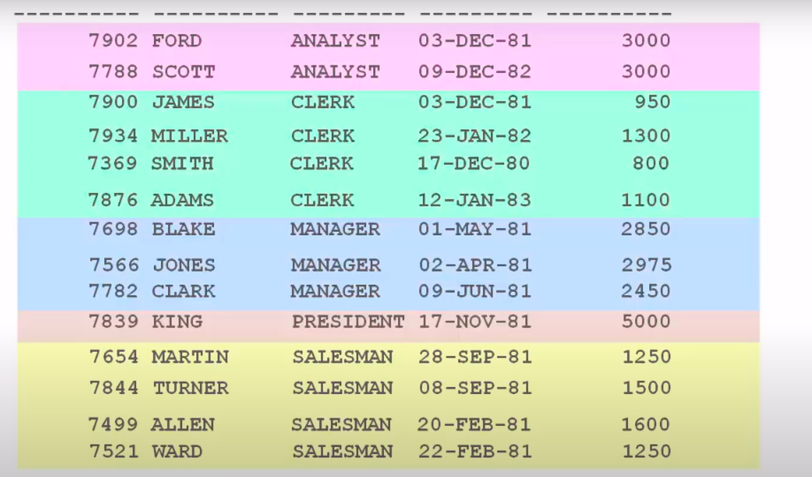


Slide 47
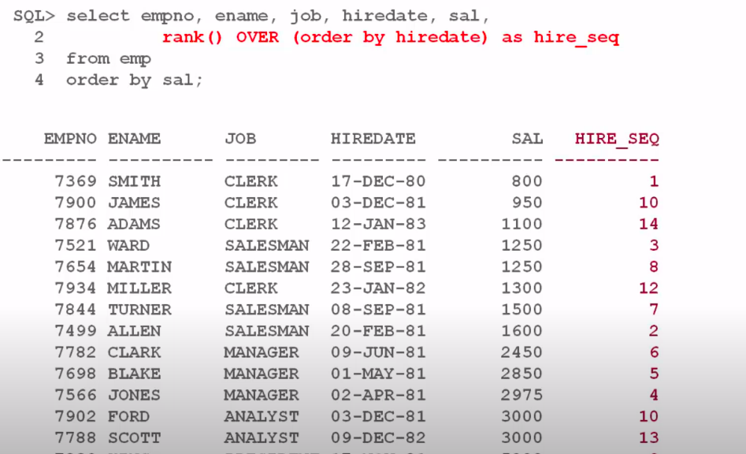

Slide 48
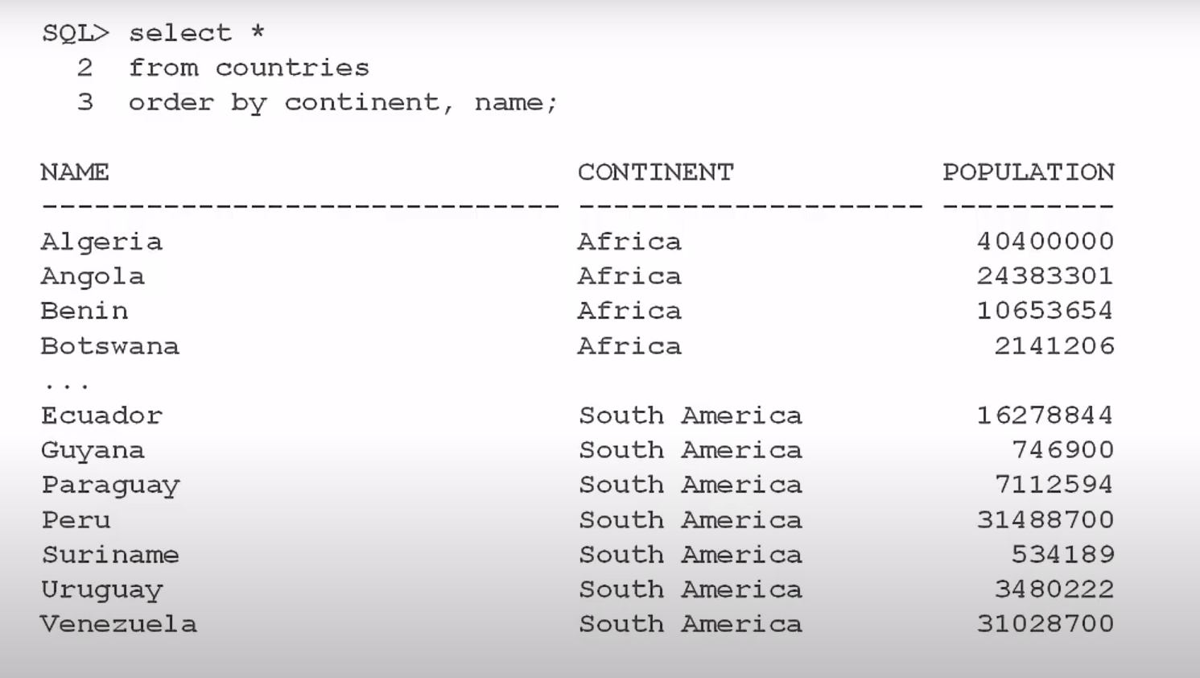

Macdonald’s

Slide 49
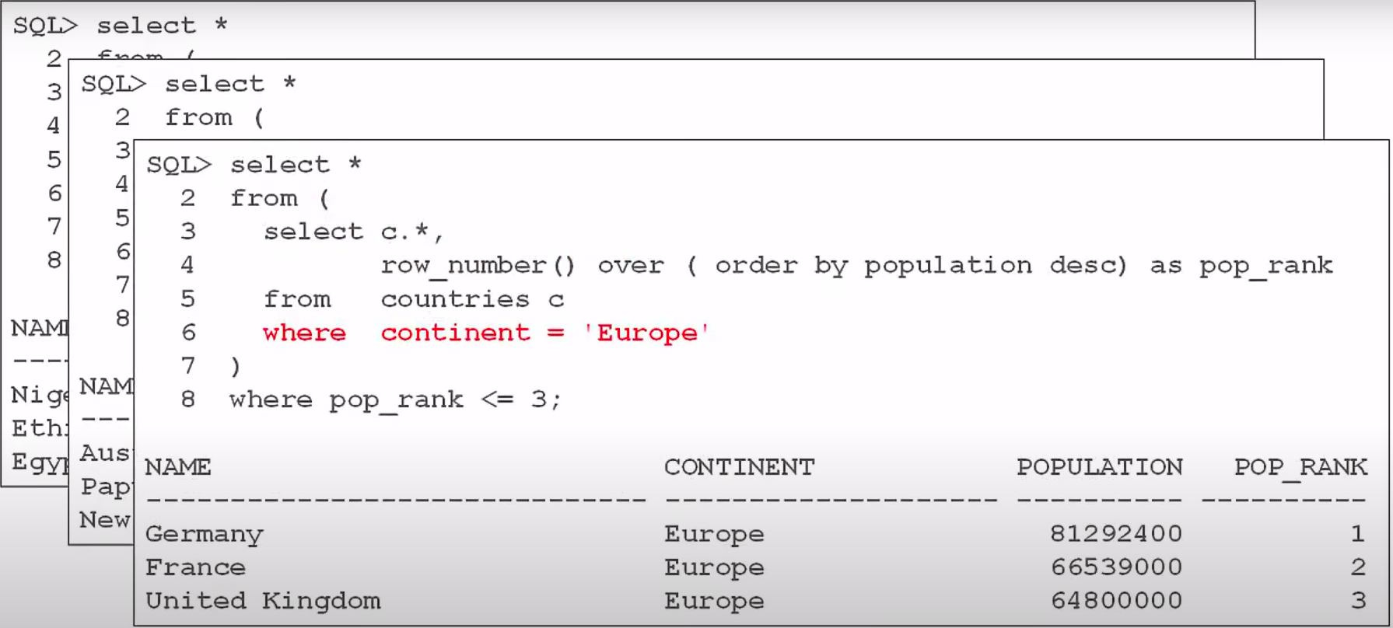

Slide 50
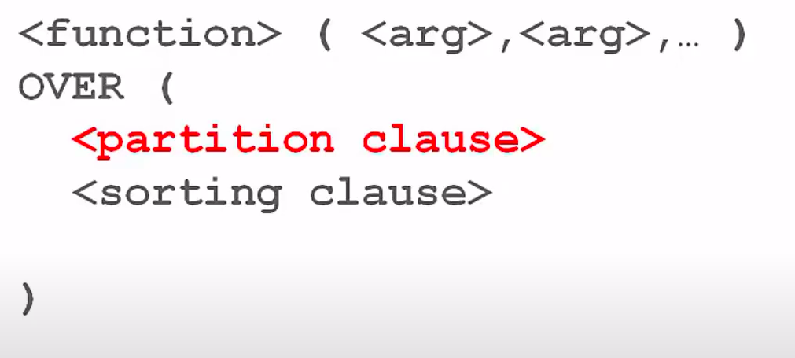

Slide 51
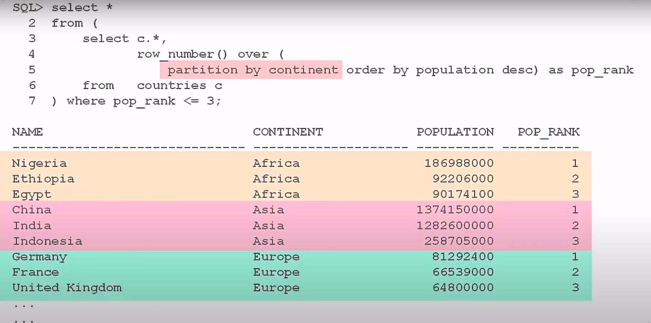

Slide 52
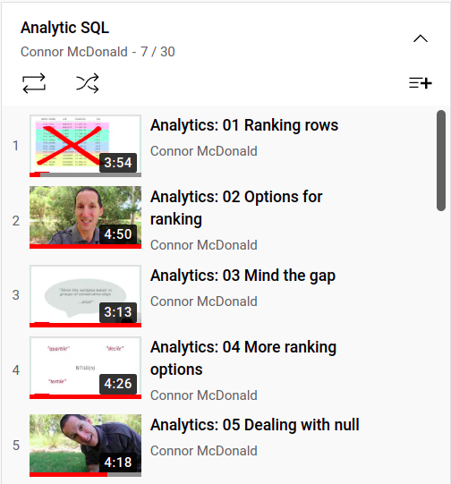
https://www.youtube.com/watch?v=G2T2z0FVVgk&list=PLJMaoEWvHwFIUwMrF4HLnRksF0H8DHGtt&index=7

Slide 53
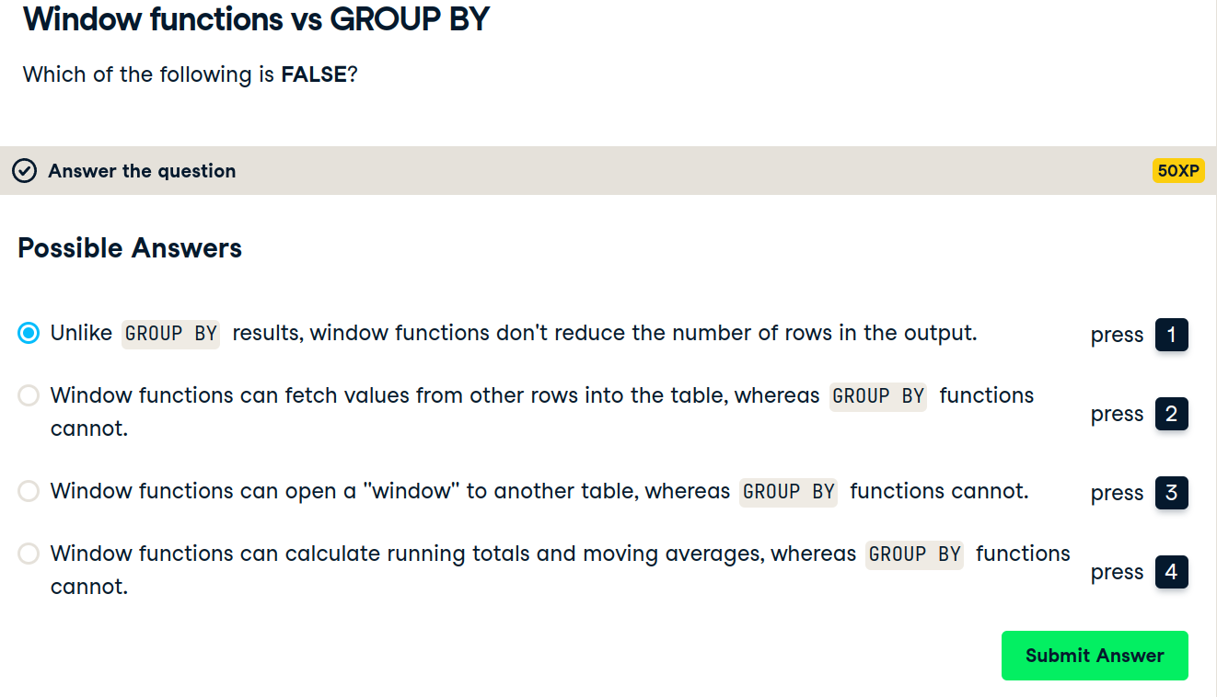

Slide 54
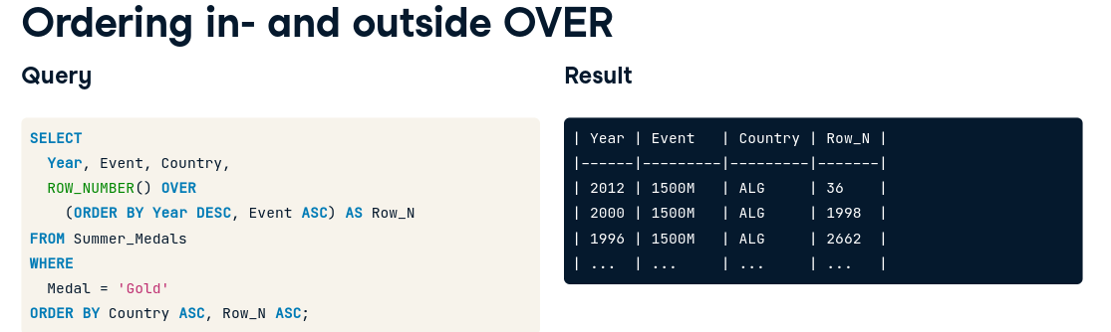

Slide 55
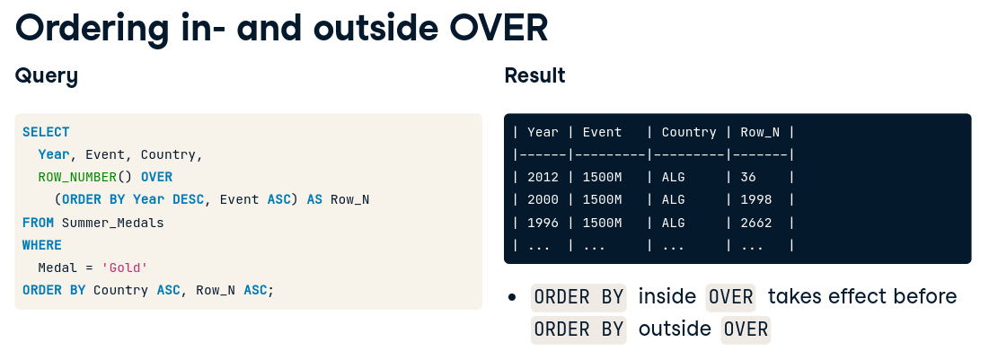

Slide 56
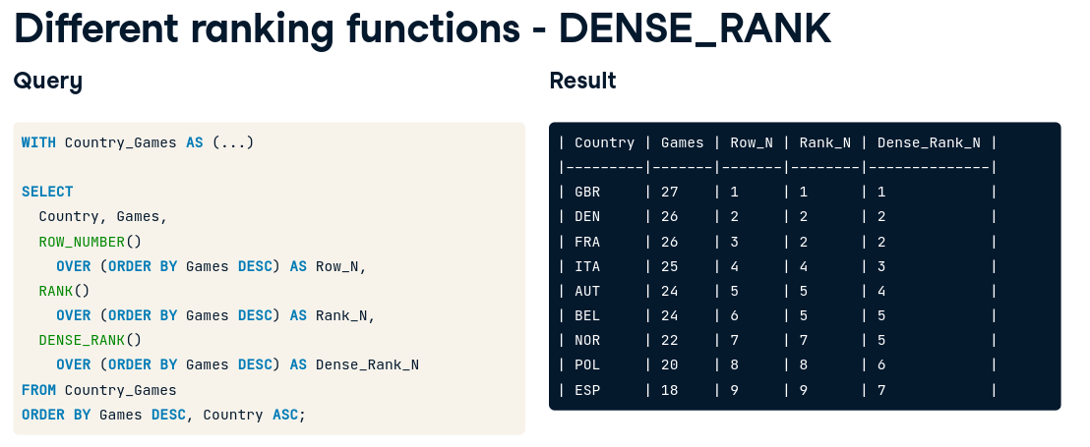

Slide 57
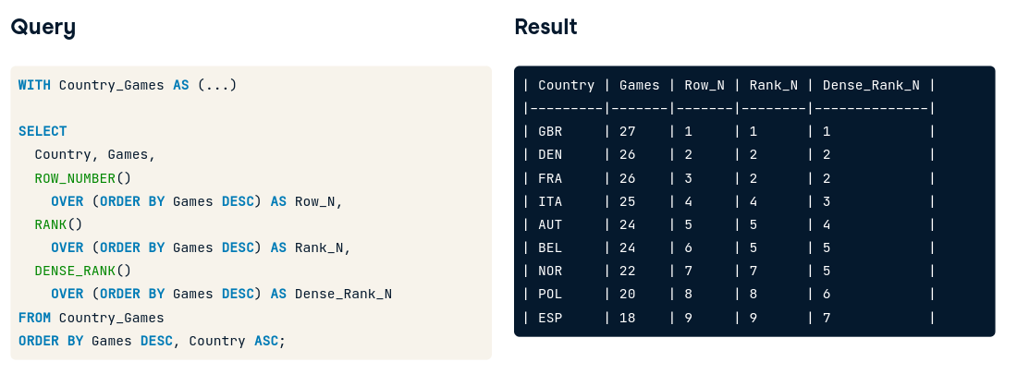

Slide 58


Slide 59


Slide 60


Slide 61



Slide 62




Slide 63


Slide 64


Slide 65


Slide 66


Slide 67


Slide 68


Slide 69


Slide 70


Slide 71


Slide 72


Slide 73


Slide 74


Slide 75


Slide 76


Slide 77


Slide 78


Slide 79


Slide 80


Slide 81


Slide 82





SQL
Notes:
Preface | Learning SQL, 3rd Edition
https://learning.oreilly.com/library/view/learning-sql-3rd/9781492057604/preface01.html#learningsql-PREFACE-2-SECT-3
‹#›

Slide 83


MYSQL DATABASE GETTING STARTED
Notes:
MySQL :: Download MySQL Community Server
https://dev.mysql.com/downloads/mysql/
MySQL :: Other MySQL Documentation
https://dev.mysql.com/doc/index-other.html
MySQL Sandbox | mysql-db-sandbox | Katacoda
https://www.katacoda.com/mysql-db-sandbox/scenarios/mysql-sandbox
‹#›

Slide 84



Notes:
A subquery is always enclosed within parentheses, and it is usually executed prior to the containing statement. In udacity, they are saying “must be fully independent”
‹#›

Slide 85

TYPES OF SUBQUERIES
Notes:
‹#›

Slide 86
HOW TO USE?
Which operator to use?
Notes:
The type of result set returned by the subquery determines how it may be used and which operators the containing statement may use to interact with the data the subquery returns
When the containing statement has finished executing, the data returned by any subqueries is discarded, making a subquery act like a temporary table with statement scope (meaning that the server frees up any memory allocated to the subquery results after the SQL statement has finished execution).
‹#›

Slide 87


HOW MANY VALUES?
Notes:
How many values do we expect this inner query to yield? What about the outer query?
‹#›

Slide 88

SCALER (1 ROW 1 COLUMN)
Notes:
How many values do we expect this inner query to yield? What about the outer query?
‹#›

Slide 89
CAN WE GET THIS WITHOUT SUBQUERY?
Notes:
Order desc then limit 1
Or maybe self join -- we need to explore this self join
‹#›

Slide 90

WHAT ABOUT THE INNER QUERY?
Which operator can’t be used?
More on this later
Notes:
The subquery returns a single row with a single column, which allows it to be used as one of the expressions in an equality condition (if the subquery returned two or more rows, it could be compared to something but could not be equal to anything, but more on this later)
All operators can be used here
‹#›

Slide 91


REWRITE
Subquery vs hard coding
Notes:
The subquery is useful in this case because it allows you to retrieve information about the customer with the highest ID in a single query, rather than retrieving the maximum customer_id using one query and then writing a second query to retrieve the desired data from the customer table.
‹#›

Slide 92



SCALAR SUBQUERIES
Inequalities
Which query produces which result?
Notes:
noncorrelated subquery may be executed alone and does not reference anything from the containing statement. Most subqueries that you encounter will be of this type unless you are writing update or delete statements, which frequently make use of correlated subqueries
‹#›

Slide 93
SOLUTION
Inequalities
Notes:
noncorrelated subquery may be executed alone and does not reference anything from the containing statement. Most subqueries that you encounter will be of this type unless you are writing update or delete statements, which frequently make use of correlated subqueries
‹#›

Slide 94

CLARIFICATION
a single thing cannot be equated to a set of things.
Notes:
If you run the subquery by itself, you will see the following results:
‹#›

Slide 95
CLARIFICATION
a single thing cannot be equated to a set of things.
How to solve?
Notes:
If you run the subquery by itself, you will see the following results:
‹#›

Slide 96


MULTIPLE-ROW, SINGLE-COLUMN SUBQUERIES
Subquery vs hard coding?
Notes:
four additional operators that you can use to build conditions with these types of subqueries.
In
not in
All
Any
While the approach on the right seems reasonable when the set contains only two expressions, it is easy to see why a single condition using the in operator would be preferable if the set contained dozens (or hundreds, thousands, etc.) of values.
‹#›

Slide 97


MULTIPLE-ROW, SINGLE-COLUMN SUBQUERIES
IN NOT IN
Notes:
four additional operators that you can use to build conditions with these types of subqueries.
In
not in
All
Any
While the approach on the right seems reasonable when the set contains only two expressions, it is easy to see why a single condition using the in operator would be preferable if the set contained dozens (or hundreds, thousands, etc.) of values.
‹#›

Slide 98

WHAT’S THE OUTPUT?

Slide 99

WHAT’S THE OUTPUT?
Notes:
When using not in to compare a value to a set of values, you must be careful to ensure that the set of values does not contain a null value, because the server equates the value on the lefthand side of the expression to each member of the set, and any attempt to equate a value to null yields unknown
‹#›

Slide 100


ALL VS ANY
Notes:
The subquery in this example returns the total number of film rentals for all customers in North America, and the containing query returns all customers whose total number of film rentals exceeds any of the North American customers.
The subquery returns the total film rental fees for all customers in Bolivia, Paraguay, and Chile, and the containing query returns all customers who outspent at least one of these three countries (if you find yourself outspending an entire country, perhaps you need to cancel your Netflix subscription and book a trip to Bolivia, Paraguay, or Chile...).
‹#›

Slide 101

هجرة ؟؟

Slide 102
MULTICOLUMN SUBQUERIES
Revisit in book

Slide 103

CORRELATED SUBQUERIES
How does it work?
Notes:
Unlike a noncorrelated subquery, a correlated subquery is not executed once prior to execution of the containing statement; instead, the correlated subquery is executed once for each candidate row (rows that might be included in the final results)
For example, the following query uses a correlated subquery to count the number of film rentals for each customer, and the containing query then retrieves those customers who have rented exactly 20 films:
The reference to c.customer_id at the very end of the subquery is what makes the subquery correlated; the containing query must supply values for c.customer_id for the subquery to execute.
The containing query retrieves all 599 rows from the customer table and executes the subquery once for each customer, passing in the appropriate customer ID for each execution. If the subquery returns the value 20, then the filter condition is met, and the row is added to the result set.
‹#›

Slide 104
CORRELATED SUBQUERIES
What affects the speed of the query ?
Number of rows in customer table
Notes:
Unlike a noncorrelated subquery, a correlated subquery is not executed once prior to execution of the containing statement; instead, the correlated subquery is executed once for each candidate row (rows that might be included in the final results)
For example, the following query uses a correlated subquery to count the number of film rentals for each customer, and the containing query then retrieves those customers who have rented exactly 20 films:
The reference to c.customer_id at the very end of the subquery is what makes the subquery correlated; the containing query must supply values for c.customer_id for the subquery to execute.
The containing query retrieves all 599 rows from the customer table and executes the subquery once for each customer, passing in the appropriate customer ID for each execution. If the subquery returns the value 20, then the filter condition is met, and the row is added to the result set.
‹#›

Slide 105


THE EXISTS OPERATOR
Which one would work?
Notes:
While you will often see correlated subqueries used in equality and range conditions, the most common operator used to build conditions that utilize correlated subqueries is the exists operator. You use the exists operator when you want to identify that a relationship exists without regard for the quantity; for example, the following query finds all the customers who rented at least one film prior to May 25, 2005, without regard for how many films were rented:
If you look at the select clause of the subquery, you will see that it consists of a single literal (1); since the condition in the containing query only needs to know how many rows have been returned, the actual data the subquery returned is irrelevant. Your subquery can return whatever strikes your fancy, as demonstrated next:
‹#›

Slide 106

SOLUTION
Both
Notes:
While you will often see correlated subqueries used in equality and range conditions, the most common operator used to build conditions that utilize correlated subqueries is the exists operator. You use the exists operator when you want to identify that a relationship exists without regard for the quantity; for example, the following query finds all the customers who rented at least one film prior to May 25, 2005, without regard for how many films were rented:
If you look at the select clause of the subquery, you will see that it consists of a single literal (1); since the condition in the containing query only needs to know how many rows have been returned, the actual data the subquery returned is irrelevant. Your subquery can return whatever strikes your fancy, as demonstrated next:
However, the convention is to specify either select 1 or select * when using exists
‹#›

Slide 107

ACTORS NEVER IN R-RATED FILMS

Slide 108
WHEN TO USE SUBQUERIES

Slide 109

SUBQUERY TYPES
Notes:
some subqueries are completely self-contained (called noncorrelated subqueries), while others reference columns from the containing statement (called correlated subqueries).
‹#›

Slide 110
PITFALLS
Exercise 1
Maybe 3
5 and 6 and 7
Notes:
some subqueries are completely self-contained (called noncorrelated subqueries), while others reference columns from the containing statement (called correlated subqueries).
‹#›

Slide 111

Want more info?
https://www.red-gate.com/simple-talk/databases/sql-server/t-sql-programming-sql-server/ten-common-sql-programming-mistakes/

Slide 112
Udacity project
Digital Music Store Database
Solved example project: [Parch and Posey Data]

Slide 113


Slide 114

4 questions

Slide 115

https://codebeautify.org/sqlformatter

Slide 116


Help is there!

